Slide 1
Universal Precautions

Slide 2
Overview
Definition
Bloodborne Pathogens
Protocols for Safety
Exposure
Quiz

Slide 3
What are universal precautions?
Universal Precautions are recommended practices used to minimize the risk of exposure to infectious diseases and pathogens (germs) carried in blood and bodily fluids
This Photo by Unknown Author is licensed under CC BY-NC

Slide 4
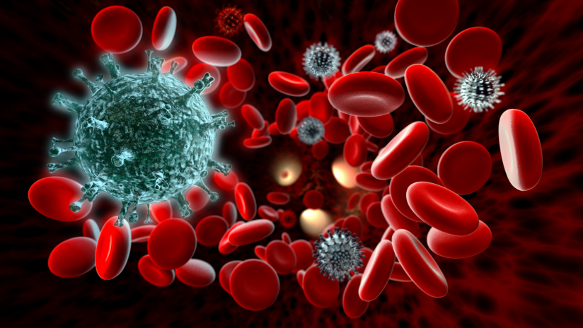
Bloodborne Pathogens
Bloodborne pathogens are infectious microorganisms in blood that can cause disease in people
Examples include:
Hepatitis B
Hepatitis C
HIV
This Photo by Unknown Author is licensed under CC BY-NC-ND

Slide 5
How are we exposed to pathogens?
Nosebleeds
Lost teeth
Cuts
Vomit
Bathroom accidents/soiled clothing
Contaminated surfaces
Tissues/bandages

Slide 6
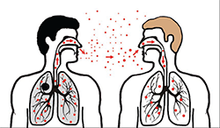
Modes of transmission
Contact from skin to skin or contaminated surfaces
Air-born infectious particles
Droplets from sneezing, coughing, or talking
This Photo by Unknown Author is licensed under CC BY-SA

Slide 7
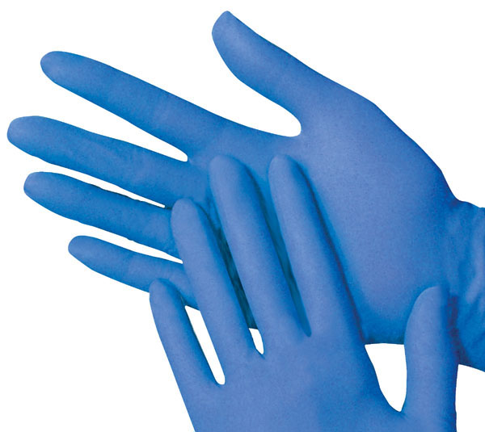
Safety Protocols
Effective hand washing
PPE (Personal Protective Equipment)
Proper disposal of waste
This Photo by Unknown Author is licensed under CC BY-SA
This Photo by Unknown Author is licensed under CC BY

Slide 8
Proper hand hygiene

Slide 9
Influenza facts and prevention

