Slide 1
Mandatory Reporting
You are a mandatory reporter.
VitalCare Staff Training
vitalcare.us

Slide 2

Mandatory Reporting
Who are Mandatory Reporters?
A mandatory reporter is a professional who is obligated by law to report known or suspected incidents of abuse and/or neglect of a child or an at-risk adult or elder.
We are Mandatory Reporters!
As “home health staff” and “child health associates,” employees of VitalCare are mandated reporters of suspected abuse of children and at-risk adults.
Once a Mandatory Reporter, Always a Mandatory Reporter
Once you become a Mandated Reporter in Colorado, you always carry this responsibility.
Notes:
Because we are a home care agency, that makes ANYONE employed a mandatory reporter

Slide 3
Mandatory Reporting
Who is an at-risk-adult?
An at-risk elder is any person 70 years of age or older.
An at-risk adult with IDD is a person who is eighteen years of age or older who has an onset of an intellectual and developmental disability before the person is 22 years old. An adult with IDD has an I.Q. of 70 or below and/or has significant limitations in the ability to socialize, provide self-care, or communicate. IDD includes autism spectrum disorders, epilepsy, cerebral palsy, developmental delays, Down Syndrome, fetal alcohol syndrome, and other disorders.

Slide 4
Mandatory Reporting
What are the reportable categories?
Physical
Sexual
Emotional
Neglect
Trafficking
Exploitation
Self-Neglect
*Many of these categories overlap. A reportable event may include multiple categories.

Slide 5
Mandatory Reporting
What’s NOT Abuse or Neglect?
Discipline
Culture
Poverty
Religious beliefs
Developmental levels

Slide 6
Mandatory Reporting
What is the reporting process?
If you or someone in the home where you’re working is or may be in immediate danger, contact 911 immediately and move to a safe place. Once you’re safe and/or help has arrived, notify your VitalCare supervisor of the events that occurred.
Contact your VitalCare supervisor. Your supervisor will help you to navigate the reporting process.
After-Hours Supervisor 720-458-0642 OR 888-664-4222
You MUST make your report to law enforcement within 24 hours of witnessing or learning of the event.
Report child abuse or neglect to the statewide child abuse and neglect hotline at 1-844-CO-4-KIDS
Report at-risk elder/adult abuse or neglect to local law enforcement. Find contact info here https://www.usacops.com/co/
Notes:
When making a report to law enforcement and/or other appropriate agencies, you will be asked to make the reporting phone call. The state requires the observing individual to file the report. Your VitalCare supervisor or an On -Call supervisor can and will be on the phone with you as support, if you desire.

Slide 7
Mandatory Reporting
What is the reporting process?
In preparation for making your report:
Write down as much as you can, as soon as you can.
Name and address of the at-risk elder/adult or child.
A description of the alleged mistreatment and the situation and what you observed.
The nature and extent of the injury.
The alleged perpetrator name and contact information, if possible.
Don’t investigate or seek details when someone is disclosing abuse to you.
Listen carefully and report what you’ve learned/seen.
Colorado Dept of Human Services requests that when the reporter is interacting with a child, they use language that is “simple, supportive, objective, and not probative.”
Notes:
Other information that will be helpful to provide when making the report includes:When you last saw the adult.
Any medical or physical conditions that impairs the adult's ability to provide for day-to-day needs.
Any memory, decision making, or understanding deficits.
Any recent decline in the adult's ability to adequately do cooking, shopping, manage healthcare, medications, or hygiene needs.
Any service providers or family/friends already in place to help address the adult's needs.
Any other information that may be relevant to adult or the mistreatment concerns.

Slide 8
Mandatory Reporting
Good Faith Reports
It’s okay to report a suspicion, a concern, even if you just suspect something is wrong. You are immune from criminal charges or civil lawsuit damages. Colorado presumes the assumption of good faith unless proven otherwise.
Failure to Report & False Reports
If you willfully fail to make a report, you are subject to a Class 3 misdemeanor which comes with 6 months in jail, $750 fine or both.
If you knowingly make a false report, you are subject to a Class 3 misdemeanor which comes with 6 months in jail, $750 fine or both.

Slide 9
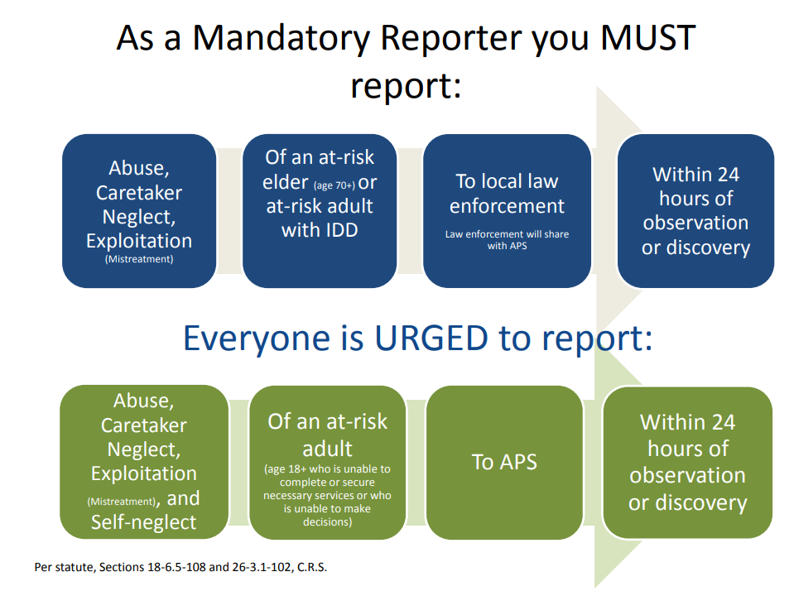
Mandatory Reporting

Slide 10
The End
Questions?
Karin Dolph 9/23/2019

