Slide 1
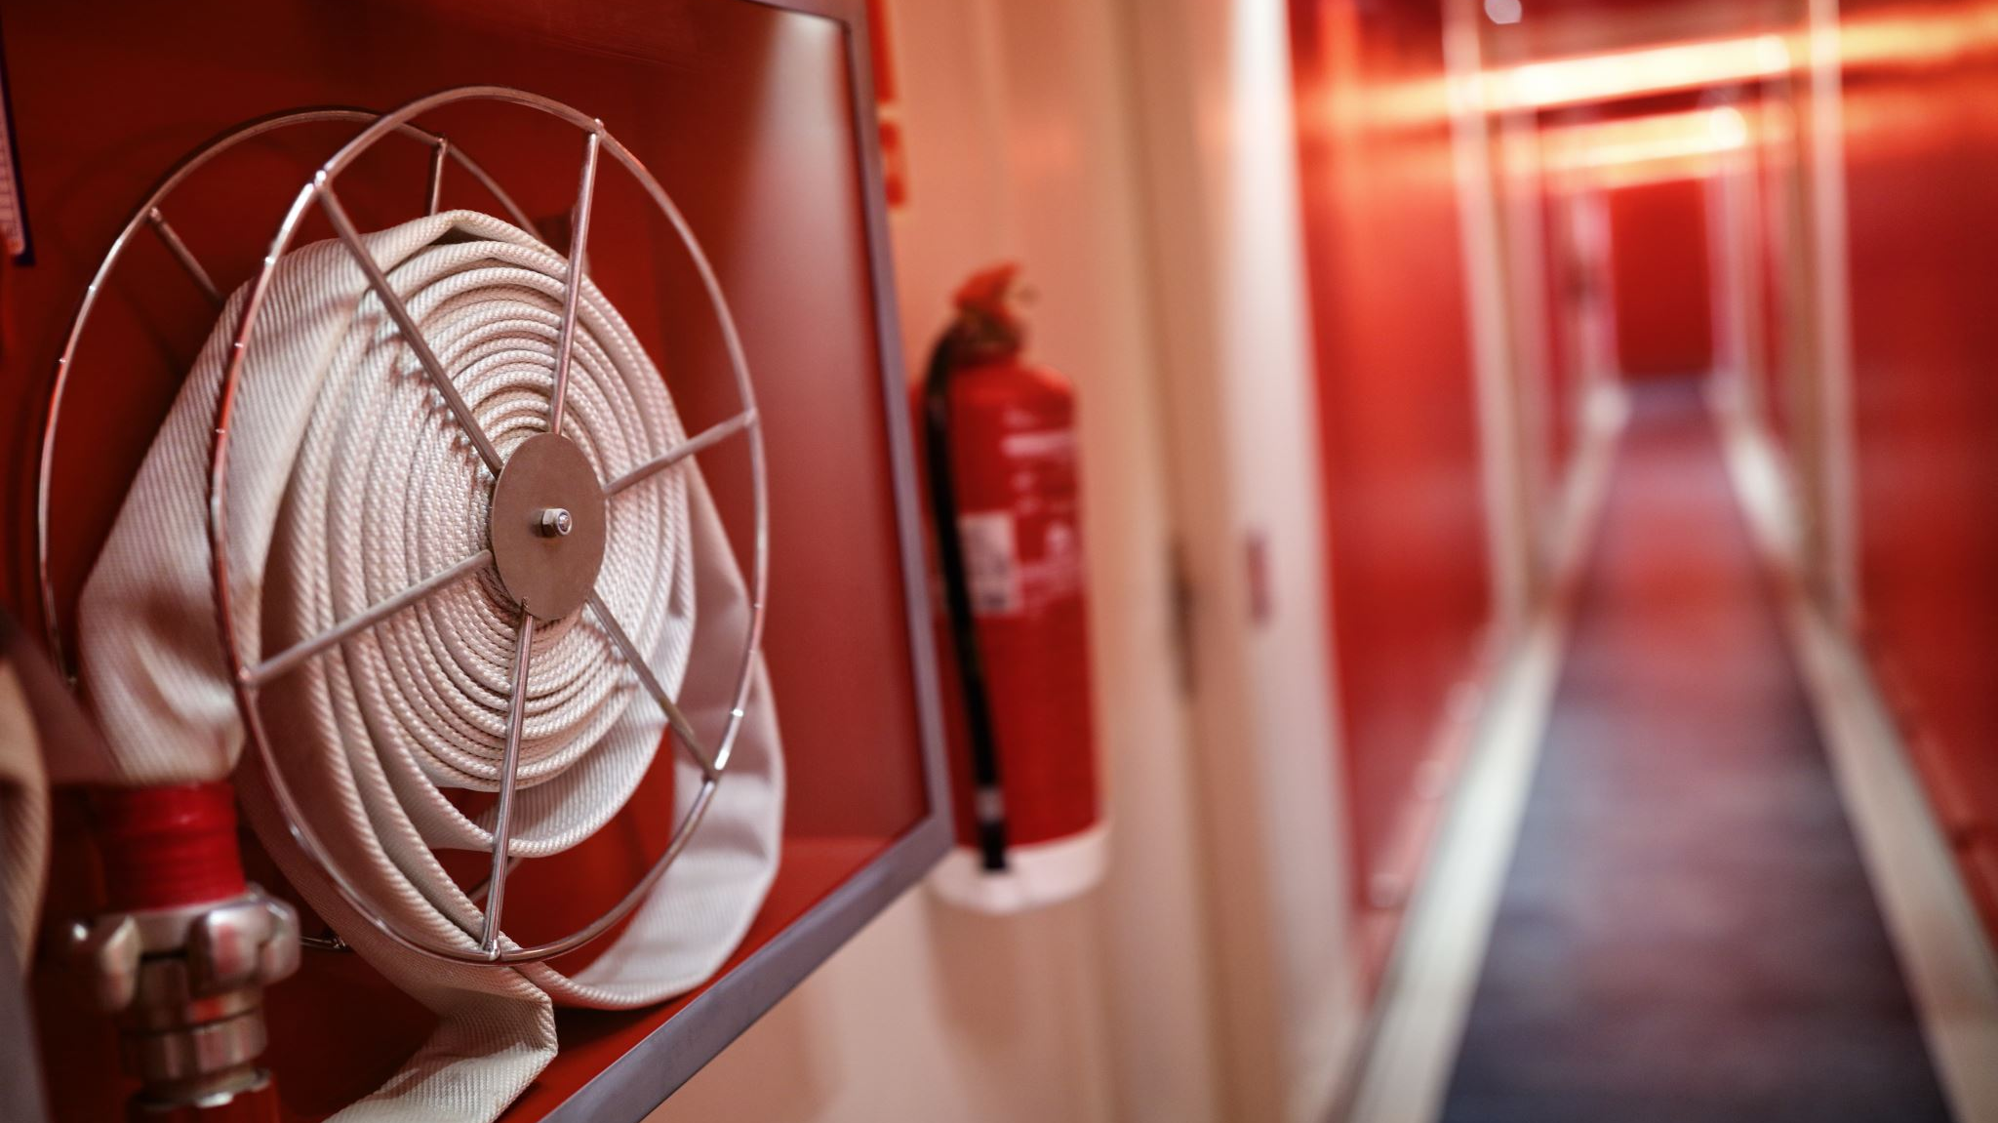
Emergency and Disaster Preparedness

Slide 2
Are you ready for a disaster?
Disasters don’t plan ahead.
You can.

Slide 3
Medical Emergency Procedures
Whenever the situation appears to be life threatening or where the consumer requires immediate transport to a hospital or emergency center, an ambulance is called immediately using 911.
Consumer’s representative is called as soon as possible when a medical emergency occurs. The alternate and/or emergency contact noted in the consumer file is contacted when the consumer representative is not immediately available.
Remember, it is not within our scope to give insulin or seizure medication (any rescue medication), so prevention is key!

Slide 4
Fire safety and procedure

Slide 5
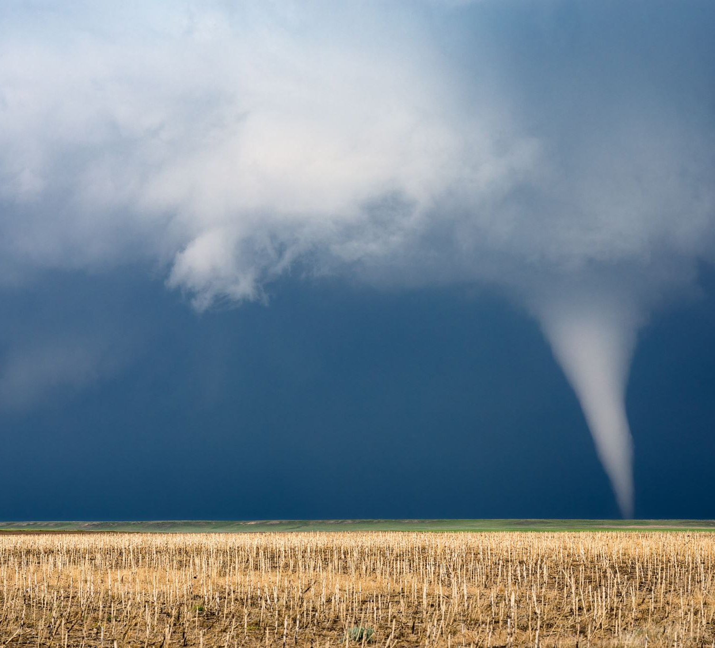
Tornadoes
Staff will monitor the radio and notify Supervisor immediately
Staff will avoid glass areas and exterior walls and will not leave the home unless existing conditions deem it advisable.
After the advisory is over report injuries and damage to emergency medical authorities via 911 first and agency Supervisor second. The Supervisor will notify the case manager (CM) and document the incident in the consumer chart.

Slide 6
Winter Words of Warning
WATCH- A winter storm is approaching
FLURRIES- Intermittent snowfall that may reduce visibility.
SLEET- Small particles of ice, usually mixed with rain. If enough sleet accumulates, it will make the roads slippery.
HEAVY SNOW- is when four or more inches are expected within a 12-hour period.
FREEZING RAIN or DRIZZLE- is forecast when expected rain is likely to freeze as soon as it strikes the ground, putting a coating of ice or glaze on roads and everything else that is exposed.
A BLIZZARD-
the most dangerous of all winter storms. It combines cold air, heavy snow and strong winds that blow the snow about and may reduce visibility to only a few yards. Winds 35 mph. temperature 20 degrees F. or less.
A SEVERE BLIZZARD WARNING-
a very heavy snowfall is expected, with winds of at least 45 mph or a temperature of ten degrees or lower.

Slide 7
Winter/Blizzard Storm Procedures
If a winter storm is on its way, the Administrator will ensure that the staff members are aware of the importance of listening to the radio or television for weather updates.
If heat is not available, staff will close off unused rooms, seal cracks around doors and cover windows using blankets, pillows, clothing, etc.
Staff will contact the agency Administrator, who will reach the consumer’s representative/emergency contact(s) for emergency pick up.
Staff will contact 911 emergency authorities in the event that no other transportation for any consumer is available.

Slide 8
Home safety
This Photo by Unknown Author is licensed under CC BY

Slide 10
